Slide 1
2018

Slide 2
BİZ KİMİZ?

Slide 3
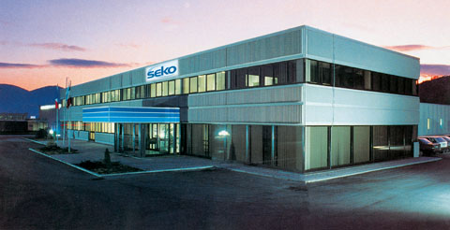
SEKO DÜNYA ÇAPINDA HİZMETİNİZDE OLAN BİR GRUP
Bir aile şirketidir.
120 ülkede faaliyet göstermektedir. (Temsilcilik, yetkili satıcı ve geniş bir dağıtım ağı)
22 ülkede kendi şubesi ve üretim merkezi bulunmaktadır.
SEKO Group

Slide 4

SEKO BİR GLOBAL GRUP
Kuruluş 1976
Tasarım ve uygulama alanında uzmanlık:
Dozaj çözümleri - Peristaltik, solenoid & motor kontrollü – ölçümlü pompa
Ölçüm & Kontrol Sistemleri

Slide 5
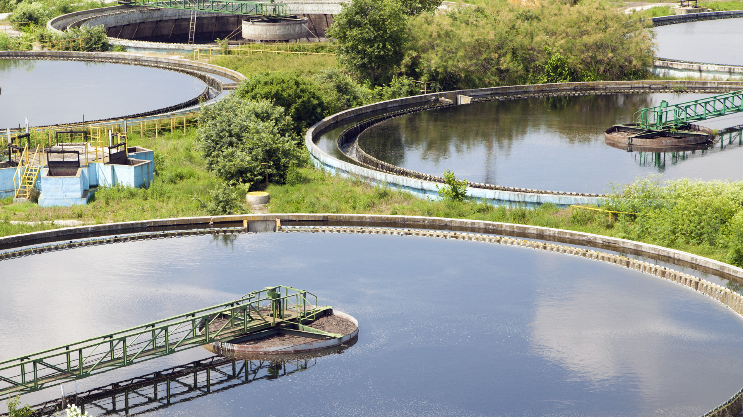
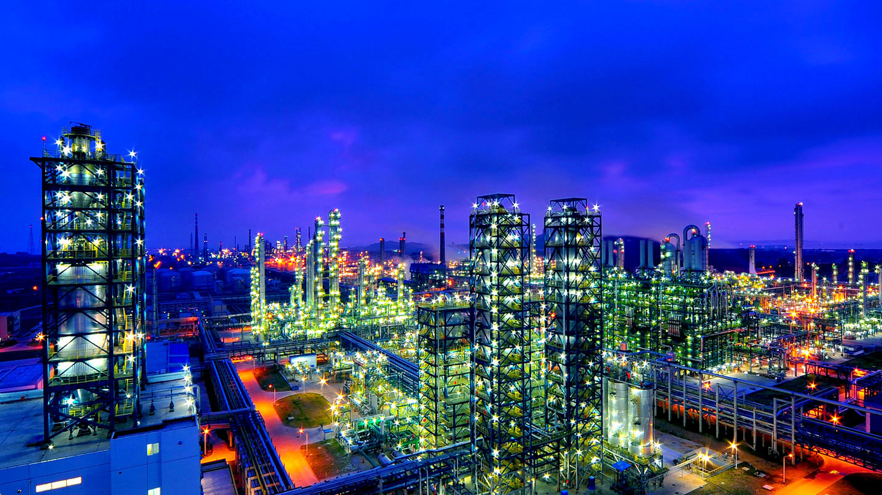
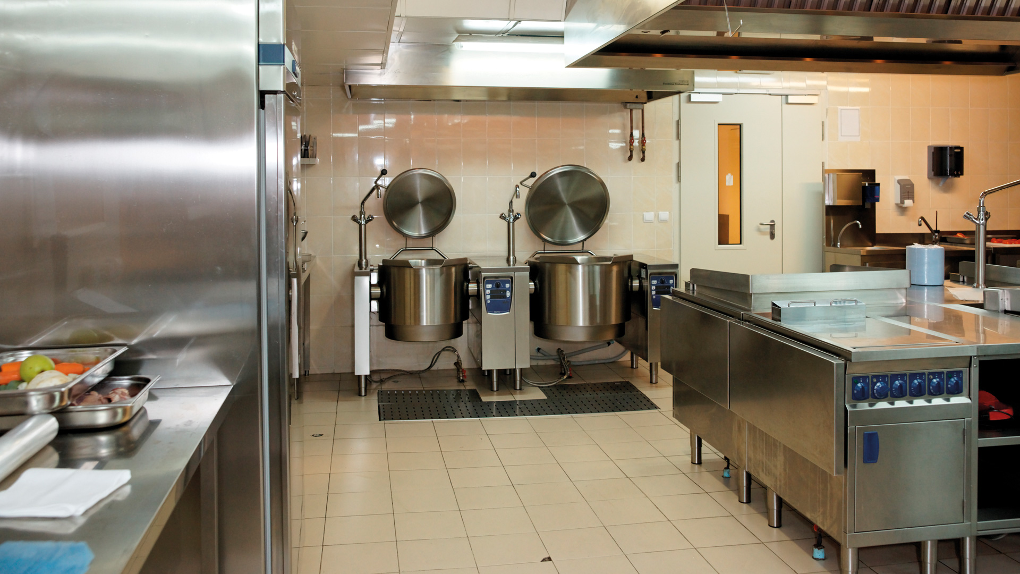
3 ANA FAALİYET ALANI
WATER & INDUSTRY
INDUSTRIAL
PROCESSES
CLEANING & HYGIENE
1
2
3

Slide 6

SEKO YILLARA GÖRE GELİŞİM
SEKO Acquires Lefranc Bosi (France)
SEKO Acquires Chemical Controls (UK)
SEKO Meksika Açılış
SEKO Güney Afrika açılış
SEKO
SE Asya açılış
SEKO
Kuruluş
Mülkiyet değişikliliği
SEKO Sieta kazenıldı (Romania)
SEKO Japonya
Açılış
SEKO Assumes Beta Technology Brand
SEKO Çin açılış
SEKO
Iberica
açılış
RISE’nin satınalınması (Italy)
SEKO Orta Doğu Açılış
SEKO USA açılış
SEKO Rusya açılış
1992
1998
2002
2005
2007
2010
2013
2015
2018
1976
1990
1995
1997
1999
2001
2003
2004
2006
2008
2012
2014
2016
SEKO
Fransa
açılış
SEKO Hong Kong Açılış
SEKO
Almanya açılış
SEKO U.K. açılış
SEKO HST kazanıldı (Brazil)
SEKO Brazilya açılış
SEKO Benelux Açılış
SEKO Acquires
FTF (Sweden)
SEKO Acquires Reciprotor (Denmark)
SEKO Türkiye
SEKO Avusturalya
Açılış

Slide 7
SEKO EKİBİ
1000
34
Notes:
Over the last 25 years SEKO’s employee numbers has significantly grown as its business has expanded and the percentage of Italian based staffed versus its non Italian staff simply reflects the international nature of SEKO

Slide 8
YILLIK CİROLAROMIZ
Yıllık Gelir
€140m
120,0
100,0
Yıllık Birleşik Büyüme
19%
80,0
60,0
40,0
Yıllık Gelir
€2.8m
20,0
0,0
1995
2018

Slide 9
VİZYONUMUZ,
MİSYONUMUZ VE BİZ

Slide 10

VİZYON
Sizin seçim partneriniz SEKO
DOZAJ ÇÖZÜMLERİ BİZİM TAAHHÜTÜMÜZ VE DENEYİMİMİZ
Notes:
Your Partner of Choice for Dosing Solutions, Globally
“Partner” relates not only to Customers but also Suppliers, and also reflects internally to our Organisation
“Choice” because all our Customers have a choice to work with SEKO or the competition. We know that for a wide number of reasons, people buy from SEKO – the People, the Personalisation, the Flexibility, the “Can Do attitude”, the real application of Partnership, the Ethical values and Personal commitment of a Family Organisation, the design, quality and value of our products etc.
“Dosing” as dosing covers all 3 BU’s, reflects still the core of our business and from where we plan to drive the next stage of our development/growth
“Solutions” because we clearly offer more than just a simple product. Our way of working reflects the attitude of listening, understanding, designing, developing and delivering our answers to meet the Customers’ needs.
“Globally” to reflect the scale and spread of our business, but also the scale to which other potential Global Customers will look for security in choosing their supplier/Partner.
It is placed at the end of the sentence giving us the possibility to appeal to growing businesses who wish to expand globally. Putting “Globally” at the front suggests we aim only at Global customers, which given our base and our heritage would be alien and would remove one of the key strengths of SEKO, proximity to the customer. The comma is designed to add emphasis when reading the sentence.

Slide 11

MİSYON
SEKO, tutkulu, adanmış profesyonel bir Global ailedir.
Partnerlerimizin her birini dinliyor ve su arıtma, endüstriyel ve şu şartlandırma ve hijyen konusunda en doğru çözümü sunmayı taahhüt ediyoruz.
Notes:
Our Mission though describes as much who we are, as much as to what we do, and recognises the how important the people who form an integral part of the company, wherever they are and whatever they do, are to the future and the good fortune of SEKO
The first part is written and dedicated to the Employees Globally, who are Dedicated, Professional and Passionate, but most importantly a Family.
“Listening to each Partner” because in our B2B world listening is the biggest skill that drives to the best business relationship over time.
We use the word “each” to reflect the individual approach we bring to our Customers and Suppliers who are effectively all our Partners, who we endeavour to treat always as a true partner
“Committed” transfers the notion of the team who’s “can do” attitude ensures that all projects and business requests get full attention, collaboration and dedication to reach a positive conclusion
“Deliver the right solution” the word “deliver” by itself suggests just the consignment and should be read with the “right solution” to pass the concept of the full process from initial contact, to design and development of the answer, to the manufacture and sale/delivery of a product or any other solution we may have, commercial or logistical or operational
Stating of the 3 Business Units’s helps identify our positioning and enables us to begin to link SEKO with the Water Industry to start to create brand association.

Slide 12

SEKO ŞİRKET ÇİZELGESİ
Notes:
The tagline connects elements from both the Vision and the Mission and reinforces the element of Choice – people choose to do business with SEKO for one or more reasons, but ultimately it is their choice, and therefore they merit our commitment. But remember also that the “Our commitment” is total not only to our customers, but also to each other and the Company’s to its employees.

Slide 13
KÜLTÜR VE İNSAN
İŞBİRLİĞİ RUHU
KARŞILIKLI SAYGI
KALİTE
Notes:
Culture and People : SEKO’s 3 Pillars
Spirit of Collaboration
We pride ourselves on how we work as a worldwide team, able to bring solutions from an idea to the real world in very short time, working as a coherent, well connected team within our SEKO Family.
This we do while also engaging and listening to our Customers, locally. We make sure that everyone in the Company understands their role in delivering the SEKO promise, committing ourselves to delivering a final solution be it for a Customer.
Our flexibility and speed to delivery can only come from an organisation that drives a spirit of collaboration throughout which can only be done thanks to our lack of hierarchies ensuring everyone can collaborate at every level.
Mutual Respect:
Doing business is about being able to generate trust between Customer and Supplier, and this trust can only be developed if there is a basis of mutual respect. So, at SEKO we believe in extending the Mutual Respect we have as an internal ethic and bringing it to our Business Partnerships.
We’ll make sure we deliver against our commitments, on time and in a transparent fashion, so you know can plan for your own business needs.
Quality:
In SEKO quality is 360°. It covers not only the design, development, production and delivery of our products and solutions but it runs through the core professionalism of our teams.
For us, being professional goes beyond the normal considerations and means acting with foresight, good reasoning and a sense of responsibility, taking care of every single aspect of our work and our interactions both inside and out of the company.

Slide 14
SEKO SİZİN İÇİN NE YAPMAYA ÇALIŞIYOR!
Uzun vadede özel mülkiyette olan bir iş
Doğru bir partner - kar ve avantajlar paylaşma
Benzersiz Ar-Ge rakamları
Uluslararası duruş
Hızlı karar verme süreci
‘Müşterinin problem ve çözümünü’ doğru anlama
İşletim sistemi ağı
Notes:
In the modern Globalised world, being a Privately owned company has significant benefits, not only for its employees and the way in which they are viewed, but also for our Customers, our Partners. It also means that we can act fast, and take the necessary decisions quickly to keep our business and projects moving quickly.
There isn’t the pressure of the short term goals, and SEKO has the ability to plan for the long term and deliver true Partnership for our Customers where both parties collaborate fully, sharing the costs and the benefits.
Our approach is to understand fully the customers’ needs, identify the biggest problems where we can bring our knowledge and experience to bear. We have the benefit of having an extensive R&D team, equating to 10% of SEKO’s total family, dedicated to finding and designing solutions.
These combined with our extensive operating company network, with local company offices in over 20 countries means that we are close to our customers wherever they are. Our international exposure is second to none, with over 20 languages spoken within the company and with offices established in key regions of the world for many years.
Exactly the same way as SEKO’s 900 strong workforce are all considered a one extended family, with our three Pillars of Mutual Respect, Quality/Professionalism and Spirit of Collaboration at the core of everything we do.

Slide 15
NERDEYİZ!

Slide 16
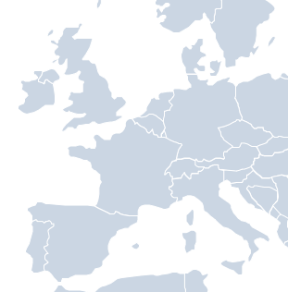
KÜRESEL GÖRÜŞLÜ,
LOKAL ODAKLI
SEKO NORDICS
SEKO UK
SEKO BENELUX
SEKO FRANCE
SEKO DEUTSCHLAND
SEKO IP
CHEMITEC
SEKO
IBERICA
SEKO HEADQUARTERS
SEKO RUSSIA
SEKO ROMANIA
SEKO USA
SEKO TURKEY
SEKO CHINA
SEKO JAPAN
IRAN REP
KOREA REP.
SEKO MEXICO
SEKO
MIDDLE EAST
SEKO HONG KONG
INDIA REP.
OFFICE
SEKO ASIA
PACIFIC
22 SEKO Şubesi
120 ülkede hizmet
SEKO BRAZIL
SEKO SOUTH AFRICA
Notes:
Red bullets are manufacturing sites
Blue bullets are fully subsidiary offices
Black bullets – India Sales Re office; Iran and Korea are fully funded Sales representatives working at local distributors.

Slide 17



SEKO GÜNEY AFRIKA
1999
Temizlik ve Hijyende ülke lideri
JOHANNESBURG
Export to SADC countries
Fully equipped training facility
Internal & external customer support team
Service and repairs centre
8

Slide 18
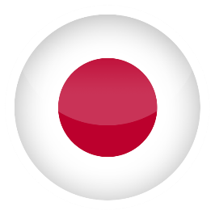

SEKO JAPONYA
2016
Focused on providing outstanding
Cleaning and Hygiene Solutions
Brings renewed energy through the SEKO
and Beta Technology brands to Japan
YOKAHAMA
2
Notes:
SEKO’s latest subsidiary which brings to Japan the benefits of SEKO and Beta Technology and reinforces SEKO’s commitment to the Asia Pacific Region. Supported by local experienced sales people and from the Head Office back in Italy, SEKO Japan consolidates our presence and our reputation.

Slide 19
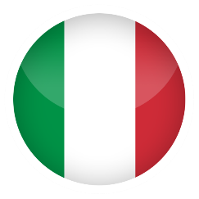
SEKO MERKEZ MERKEZ OFİS
1976
Rieti bölgesinde yaklaşık 4,000 m2 alanına sahip Seko Merkez Ofisi
Ar-Ge
RIETI
Test Lab.
Destek fonsiyonları
Italya Ülke ofisi
Depo alanı
Üretim tesisi
166
Notes:
SEKO’s global head quarters, covering over 4000 sqm, based in Rieti and home to over 150 people covering R&D, Manufacturing, Logistics, Factory engineering, Sales, Marketing, Customer Service and Finance. It also houses our test labs and is the central warehouse for many of our subsidiary operations and is the core of our Lean Manufacturing philosophy that has then been expanded to our other production plants.

Slide 20
SEKO ENDÜSTRİYEL PROSESLER
1963
Milan bölgesinde yaklaşık 2,600 m2 alana sahip Seko Endüstriyel Prosesler ofisi
2002 de Exacta’yı satın alarak Seko’nun petrol ve gaz endüstrisine girmesini sağladı.
MILAN
Dozaj çözümleri için endüstriyel prosesler ve tasarımlar:
API 675 standartlarında dozaj pompaları
API 674 standartlarına göre dozaj pompaları
69
Notes:
Since 1963, operating originally as Bono Exacta, SEKO’s Industrial Process Division has designed and developed solutions for complex industrial processes including the for the Oil and Gas sectors. With an accumulated experience of over 50 years, SEKO has built a reputation as a true technological leader and has partnered with major sector players, keen to leverage that know-how. Today the Business unit specialises in producing API 674 process pumps, API 675 metering pumps

Slide 21
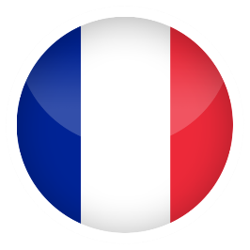
SEKO FRANSA
1991
PARIS
Dozaj pompası konusunda ülke lideri
French company covers 2,300sqm
Surface cleaning foaming systems
Developing plastic dosing skids
53
Notes:
The acquisition of Lefranc Bosi dosing in 2006 allowed SEKO to become the French leader in the dosing pump industry. The French business covers over 2,300 sqm and is our centre of production of foam cleaning systems and the production of plastic dosing skids. As such the French business is one of the largest subsidiaries and is a clear leader in the Cleaning and Hygiene market, as much as the Water industry.

Slide 22

SEKO BİRLEŞİK KRALLIK
2008
Satış sonrası ve Kimyasal çözümler konusunda ülke lider
Fully equipped training facility
Service centre
Deliver next day from warehouse
HARLOW,
ESSEX
Global Marketing Communications offices
19
Notes:
The acquisition of Chemical Control brought the UK leader in Cleaning & Hygiene into the SEKO group, dominating supply to the largest cleaning and hygiene providers in the UK.
SEKO UK offers a fully equipped training facility, supported by our internal and external customer support teams as well as a service centre and outstanding ability to deliver next day from its finished stock warehouse.
Further, Harlow now also houses SEKO’s Global Sales and Marketing office, from where global sales and marketing communications is run, bringing the core values of the SEKO brand to life with our Partners.

Slide 23



SEKO USA
2001
Depo ve teknik destek hizmetleri
Acquired Beta Technology, leading dosing
equipment supplier to Hygiene market
TULLYTOWN (PA)
SEKO moves to category leading position
Products all fully certificated,adapted for
use in the US market
7
Notes:
SEKO has been present in the US for 15 years establishing a reputation for high service and great products.
The business acquired Beta Technology in 2016 and together with SEKO’s existing product range takes SEKO to a category leading position, able to deliver value add solutions in the Cleaning and Hygiene market across the US.
The product ranges are naturally all fully certificated and adapted for use in the US market

Slide 24
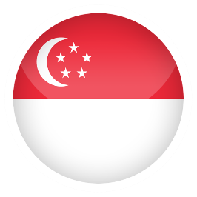

SEKO SINGAPORE
1999
Asya bölge ofisi
Modern training facilities
SINGAPORE
Manages our Regional Network of Professional
sector expert Partner Distributors
5
Notes:
Our ASEAN Regional office is from where we manage our business in Water & Industry and Oil & Gas through our network of Professional sector expert Partner Distributors.

Slide 25
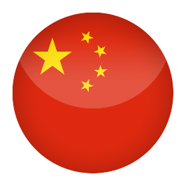
SEKO ÇİN
2003
Zhuozhou bölgesinde yaklaşık 7000 m2 alan
Largest production plant
Research & Design labs
ZHUOZHOU
(HEBEI)
Chemical and 3D Metrology labs
North Asian Regional Office
281
Notes:
Our plant in China at 7000 sqm is the largest of SEKO’s production plants and provides outstanding capacity ability for SEKO to manage the largest requirements of our customers. At the same time, the facility forms an integral part of the RD&D operation and is fully equipped with labs, chemical and mechanical and has the latest equipment including 3D metrology.
It also acts as a regional office for the north Asian markets.

Slide 26

SEKO ROMANYA
2006
Romania
CLUJ - NAPOCA
Industrial Processes business
Dedicated electromechanical engineers
Develop hard and software technology
130
Notes:
Our Romania plant covers 6000sqm and is especially focused on the design and production of dosing skids for major projects in the Industrial Processes business.
It is also the base for a team of dedicated electromechanical engineers who complement the mechanical engineers at Rieti and work with the team in China to further develop SEKO’s hard and software technology.

Slide 27
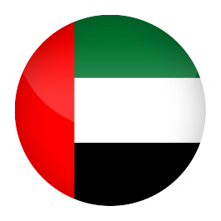
SEKO ORTADOĞU
2012
Dubai
Gulf coverage for 3 SEKO Business Units
Test Facilities for Industrial Process Pumps
SHARJAH
Full Service team to support SEKO business
9
Notes:
Our Middle East offices are amongst our most modern. A modern premises of 400sqm it delivers sales and technical support for our 3 Business units, covering Hygiene, Water and Industrial processes.

Slide 28


SEKO IBERICA
1991
Iberia ofis, depo ve teknik hizmerler.
Temizlik/hijyen ve Havuz/spa projelerinde ülke lideri
BARCELONA
19
Notes:
The first subsidiary to be opened outside of Italy, the Spanish business is now a national leader in the cleaning and hygiene and water treatment arena, contributing to SEKO’s leading position for example in the Swimming Pool sector.

Slide 29



SEKO ALMANYA
1998
Ofis, depo ve teknik hizmetler
National leader in Cleaning & Hygiene
Technical service support
MAINZ
Service and repairs centre
14
Notes:
Our German organisation delivers SEKO’s Cleaning and Hygiene solutions through a dedicated team of sales and technical sales/service employees. Covering also the other German speaking nations of Austria and Switzerland, the team also offers a specific service and repairs centre offering the quickest response time for our customers.

Slide 30

SEKO BRAZIL
2005
Brazil office, with warehouse and test facilities
Manufacturing Cleaning & Hygiene products for
local market
R&D capabilities to adapt product to local needs
SÃO PAULO
Service and repairs centre
13
Notes:
Represents our smallest manufacturing plant producing Cleaning & Hygiene products for the local market which includes taking some limited R&D capabilities to adapt product to local needs
The offices here export to the some parts of South America where they are not served from Rieti and also offer a service and repairs centre

Slide 31
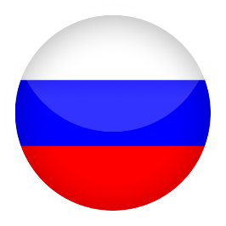
SEKO RUSYA
2004
Rusya ofis ve depo
National Leader Cleaning & Hygiene and
Water & Industry
Technical support service
MOSCOW
Service and repairs centre
17
Notes:
The team in Russia provide SEKO’s solutions in both the Cleaning & Hygiene and Water & Industry sectors and are recognised amongst the key suppliers of dosing solutions there supported by a technical support team.

Slide 32

SEKO TURKİYE
2010
Turkish ofis, depo ve teknik hizmetler
Temizlik/Hijyen ve endüstriyel su şartlandırma konularında ülke lideri
ISTANBUL
Servis mühendisliği
Servis ve onarım merkezi
17
Notes:
A national leader in the Cleaning & Hygiene and Water & Industry in Turkey, supported by a sales and technical support team. From our two bases here we are able to provide quick response times to customer needs and offer a service and repairs centre.

Slide 33
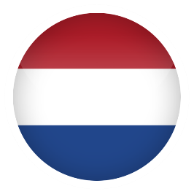
SEKO BENELUX
2013
Benelux office, warehouse and technical
support
National leader in C&H
ENSCHEDE
National network of service engineers
4
Notes:
A dynamic team provide country leading sales and technical support in the cleaning and hygiene sector, whilst also growing the SEKO presence and penetration in the water industry, with plans to double in size in the coming couple of years.

Slide 34

SEKO MEXICO
2014
Centrally located office
Distributor Management Cleaning & Hygiene
and Water & Industry
After sales support
MEXICO CITY
2
Notes:
One of our smallest subsidiaries but with great plans for growth and taking the SEKO know how in cleaning and hygiene and the water industry to the customers.

Slide 35

SEKO HONG KONG
2015
Commercial office providing additional regional support
Management distributor Asia market
operating Water & Industry and Oil & Gas
After sales support
HONG KONG
2

Slide 36




SEKO NORDICS
2007
Represented in the Nordics by Reciprotor
Leading distributor in the region
Full sales and technical support
Recognition as leader in Cleaning and Hygiene
KOGE
4
Notes:
SEKO is represented in the Nordics by Reciprotor, a leading distributor in the region offering full sales and technical support across a range of products and solutions.
Reciprotor’s brand recognition as leader in Cleaning and Hygiene is the principal reason for the continued promotion of the brand.

Slide 37
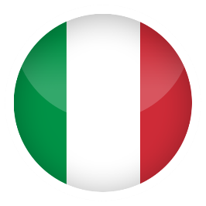

CHEMITEC
2010
Headquarters in Florence
FLORENCE
ITALY
Analysers, probes, level and flowrate detection
systems
Customers worldwide in Water Treatment and
Liquid Chemical Analysis
Chinese subsidiary opened 2016
SHANGHAI
CHINA
16
Notes:
Chemitec is a stand alone company within the SEKO Group. It designs, manufactures and distributes analysers, probes and level and flowrate detection systems to Customers worldwide in Water Treatment and Liquid Chemical Analysis.
From their base in Florence, and more recently in Shanghai, they offer service and repairs through a network of service engineers.

Slide 38
KALİTE KONTROL

Slide 39
KALİTE YÖNETİM SİSTEMLERİ
40 yılın
üzerinde
100%
Yüksek kaliteli ürünler
Güvence altına alınmış üretim
Yüksek Test parametreleri
Ürün kalitesi Kontrol planı
Fabrika çıkışından önce test aşaması
ISO9001
certified Company since 1999
ISO 9001, 14001
& OHSAS 18001
Production IT, RO & CA
In house designed and developed test benches
ATEX
certified since 2009
IECEx
certified since 2013
Products fully tested prior to dispatch
Notes:
SEKO has been producing premium quality products for over 40 years and all products are engineered to be rugged, durable, and reliable
ISO9001 certified since 1999
Constantly updated management systems to latest version (currently ISO9001: 2008).
Our 3 principal production facilities have all attained ISO 14001 and OHSAS 18001 certification, giving global assurance of our product quality.
The ISO 14001 Environment Management System (EMS) standard is an internationally recognised environmental management standard. It is a systematic framework to manage the immediate and long term environmental impacts of an organisation's products, services and processes.
OHSAS 18001 is an Occupation Health and Safety Assessment Series for health and safety management systems. It is intended to help an organizations to control occupational health and safety risks. It was developed in response to widespread demand for a recognized standard against which to be certified and assessed.
Product test benches are designed and made internally to follow our strictest test parameters
Product Quality control plan designed to meet Customer requirements
ATEX certified since 2009 and IECEx certified since 2013 bringing strict controls in terms of our product build quality and our electrotechnical conformity.
SEKO Italy quality system is also certified according to ISO IEC 80079-34 which is still connected to ATEX and IECEx requirements.
The difference between ATEX and IECEx is initially that ATEX is only valid in the EU and IECEx aims for global acceptance. ATEX is legally required for all electrical and non-electrical equipment in hazardous environments. IECEx is only intended for electrical equipment in hazardous environments.
100% of the finished goods are tested prior to leaving the factory and our 3 principal factories are certified ISO9001 as additional guarantee of our consistency of performance.

Slide 40














KALİTE
ULUSLARARASI
GÜVENLİK &
ÇEVRE
KURALLARI
SERTİFİKALARI
Notes:
Quality as we have seen is one of SEKO’s 3 Pillars. Our products have to guarantee the safety and security not only of the users but also their customers and their company reputations.
SEKO therefore ensures that it operates following ISO standards (audited by DNV) and our products comply with the CE mark as appropriate.
Some countries have their own regional certifications of conformity such as EAC, for Russia and the Stans.
Our product plants for Industrial Processes are certified by Achilles and FPAL meeting strict Oil and Gas sector requirements.
Our products and their components are also certified, for electronics for example we have IEC, for sprayers NSF. Our pumps meet ATEX requirements were required.
As our products often have direct interface with water systems, we are highly focused on ensuring compliance with the many water authorities regarding the safe and reliable application and installation of our systems – KIWA, WRAS, ACSE and DVGW amongst many other along with specific industry certifications such as UPC and ASSE.

Slide 41
ARAŞTIRMA, GELİŞTİRME VE TASARIM

Slide 42

ARAŞTIRMA, GELİŞTİME VE TASARIM
İş gücünün %10 dan fazlası Ar-Ge çalışması
Dünyaca tanınan yenilikçi çalışmalar
Disiplinli mühendislik ekipleri
2018 yılında 10 yeni ürün lansmanı
2018 yılında 15 patentli ürün
Notes:
Over 10% of the SEKO workforce is employed within our R&D organisation and with over 20 patents in the last 15 years, our ability to find innovative solutions to sometimes complex problems is recognised worldwide
Multidisciplinary teams of mechanical, chemical, hydraulic and electronic engineers in 3 labs across Italy, Romania and China
Over 20% of our business comes from new products with 150 alone in 2015
39 patents registered to SEKO – 20 in the last 5 years

Slide 43
SATIŞ VE PAZARLAMA

Slide 44

SATIŞ VE PAZARLAMA
Ortaklıklar
200 satış ve pazarlama uzmanı
22 den fazla dil
120 ülkede satış ağı
Notes:
Partnership in true sense is key to SEKO and to the customer focused team of more than 200 Professionals who cover the sales and marketing function
International sales network, expands across 120 countries through local Company offices, sales agents and Partner Distributors
Your language is our language and in SEKO we speak more than 20 languages

Slide 45
ÜRETİM

Slide 46
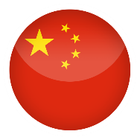

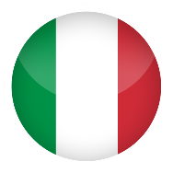
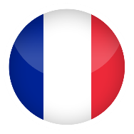
ÜRETİM
Üretim süreçlerimiz Kaizen prensibine göre yürütülür ve pazar ihtiyaçlarındaki ve müşteri talebindeki değişikliklere karşı oldukça esnek ve duyarlı olmamızı sağlayan oldukça etkili ve yalın bir üretim sistemi sunar.
Sustained through ISO certificated management processes
4 principle production sites established lean production processes
Zhuozhou
(Seko Asya)
Cluj
(Seko Romanya)
Rieti/Milan
(Seko Spa)
Paris
(Seko Fransa)
13 plastic molding machines
from 40 to 450 t
800 moulds
3D metrology laboratory and Chemical Laboratory
15 centres CNC multi-axis
3D metrology room of measurement CAD / CAM
Automatic pump test systems
Test bench production
Automatic test facilities
Chemical laboratory
Climate chamber for robust testing
EMC test facilities
Test facilities
Principal producer of spray foam solutions
Designs and manufactures plastic skids

Slide 47
EĞİTİM & ÖĞRETİM

Slide 48

EĞİTİM
Rieti merkezde tam donanımlı eğitim merkezi
4 Kıtada eğitim merkezleri
Eğitim için:
Müşterilerin teknik eğitimleri
Ticari Birimler
Distribütörler
Notes:
Fully equipped training facility at the Rieti head office as well as training centres in other principal country offices, UK, France,
Education and training offered to our Customers technical teams, to commercial teams and also to the partner distributors by the Technical Experts within SEKO’s teams

Slide 49
İŞ BİRİMLERİMİZ

Slide 50
SU & ENDÜSTRİ
Ürünlere Genel Bakış
Notes:
SEKO’s dosing solutions for water treatment include solenoid metering pumps, motor driven mechanical pumps, measure and control instrumentation and a wide range of accessories. Our expertise has led us to develop specific products for different applications across the various markets in which both SEKO and its customers have been leaders for years.
Our Customer centric development programme has led to the development of dosing systems for swimming pools, pumps and integrated measuring instruments and pre-assembled panels for measuring and monitoring the chemical and physical properties of water.
The design of metering units with tanks, stirrers, metering pumps and their accessories, together with systems for the automatic preparation of polyelectrolyte solution, complete the range of products.
SEKO currently supplies products to the following sectors:
Potable Water
Waste Water
Swimming pools
Cooling Towers
Irrigation
Condensers
Car Washing
Reverse Osmosis
Boiler Water Treatment
Bottling Plants
Dairies
Breweries

Slide 51
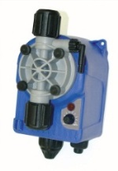
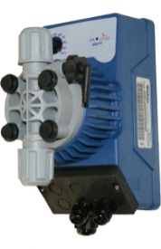
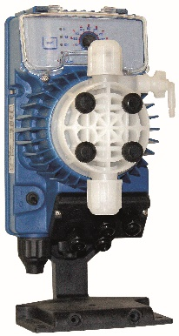
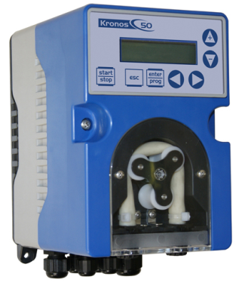
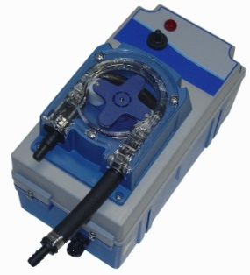
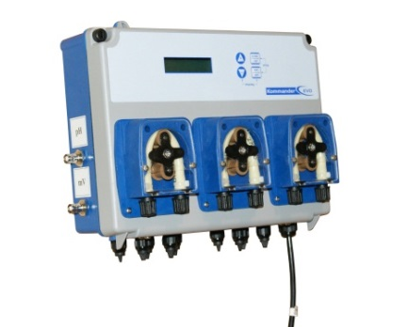
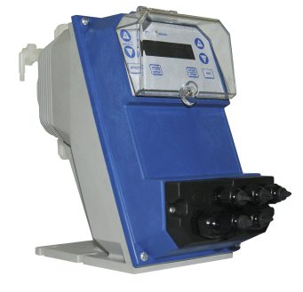
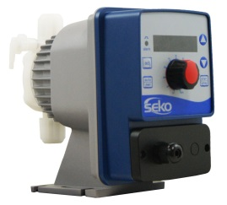
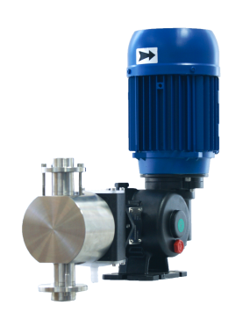
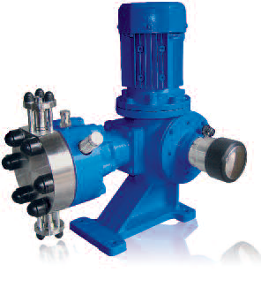
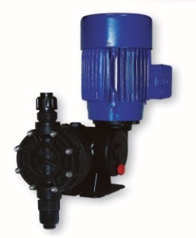
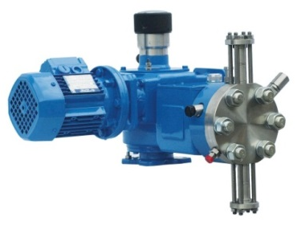
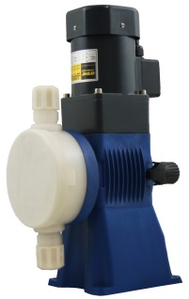
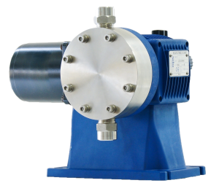
SU & ENDÜSTRİ
DOZAJ
Solenoid metering pumps
Peristaltic pumps
Motor driven pumps

Slide 52
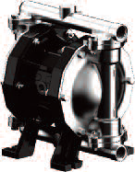
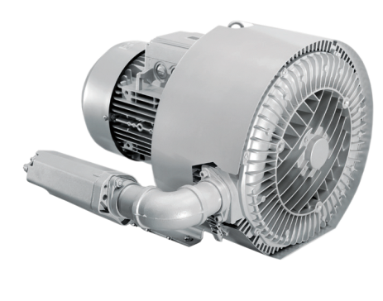

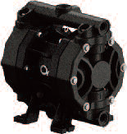
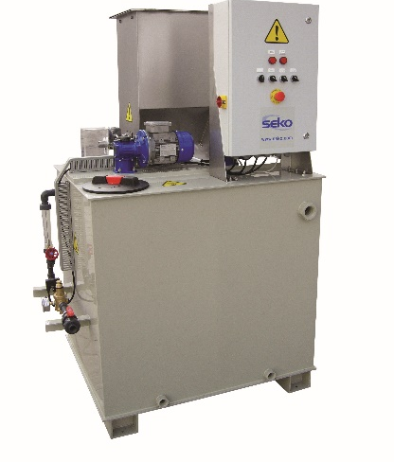
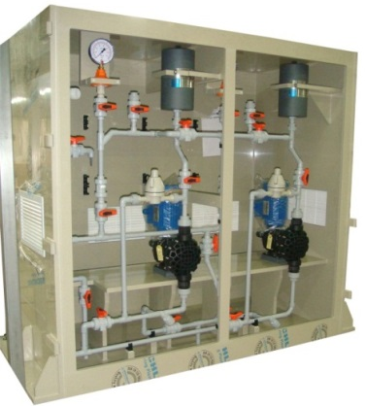
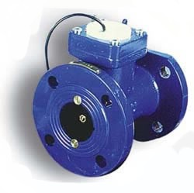
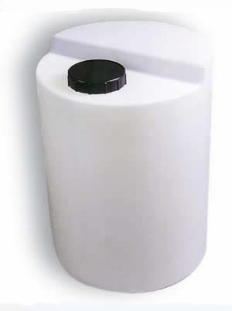
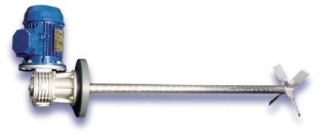
SU & ENDÜSTRİ
TRANSFER, BLOWER, SKID SİSTEMLER
Air operated double diaphragm pumps
Blowers
Polymer preparation and dosing skid
Accessories

Slide 53
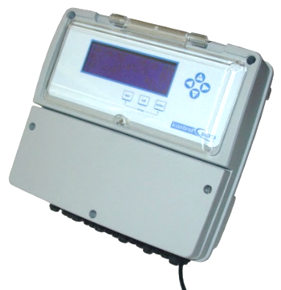
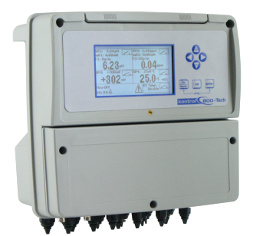
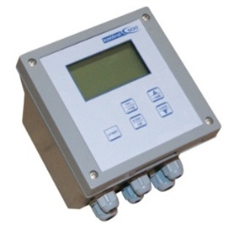
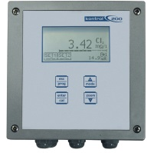
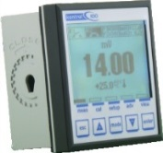
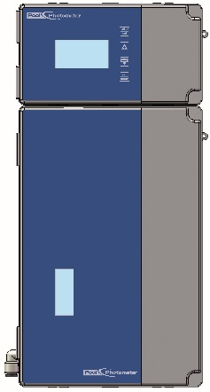
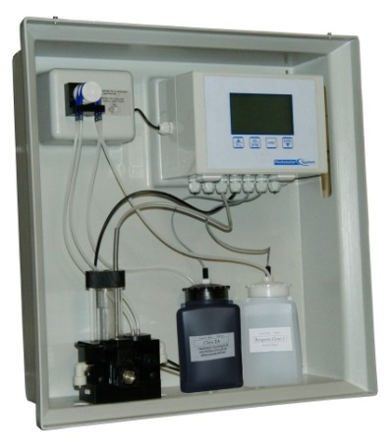
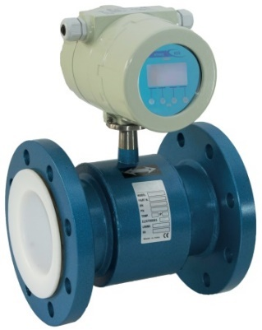
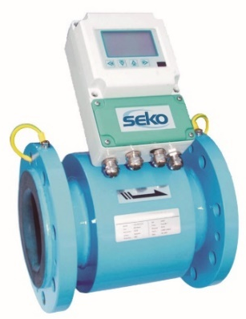
SU & ENDÜSTRİ
KONTROLÖRLER, AKIŞ, SEVİYE ÖLÇÜMÜ
Single and multiparameter controllers
Flow measurement
Photometer systems

Slide 54




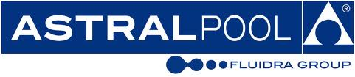









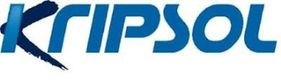




SU VE ENDÜSTRİ
REFERANSLARIMIZ

Slide 55
ENDÜSTRİYEL PROSESLER
Ürünlere Genel Bakış
Notes:
For over 40 years SEKO has linked their success to a wide range of industrial fields by supplying complete dosing systems and engineered solutions throughout the world.
SEKO develops its own projects to best solve metering and pumping problems related to different fluid properties and plant operating conditions. Diaphragm and plunger type process and metering pumps are produced by SEKO to its own proprietary designs, covering a wide range of performances:
Plunger metering pumps (according to API 675 standards) for flow rates up to 8,000 l/h and pressures up to 1,000 bar
Diaphragm metering pumps (according to API 675 standards) for flow rates up to 8,000 l/h and pressure up to 300 bar
Reciprocating Triplex process pumps (according to API 674 standards) for flow rates up to 57,000 l/h and pressures up to 1,200 bar
The product range is completed by dosing systems, including units for the preparation, dilution, storage and dosing of chemicals.
SEKO currently supplies products to the following sectors:
Oil & Gas
Energy
Petrochemical
Water Treatment
Steel Manufacturing
Ceramics Production
Paper Mills
Food and Beverage
Textile Production
Pharmaceutical industry

Slide 56








ENDÜSTRİYEL PROSESLER
ÖLÇÜM POMPALARI - API 675

Slide 57






ENDÜSTRİYEL PROSESLER
PİSTONLU POMPA - API 674

Slide 58
























ENDÜSTRİYEL PROSESLER
REFERANSLARIMIZ

Slide 59
TEMİZLİK & HİJYEN
Ürünlere Genel Bakış
Notes:
SEKO has always succeeded in combining ongoing technological innovation with the customary reliability of its products, to develop internationally avant-garde systems for the industrial cleaning and hygiene market.
Individual peristaltic pumps and dosing systems for industrial dishwashers, laundry machines and dilution and dispensing stations for concentrated chemical cleaning products for different types of surface are only an example of our product development based on the specific requirements of an ever changing market and Customer expectation.
When it comes to the washing, cleaning and disinfecting of various surfaces SEKO offers spray products for dilution with Venturi systems capable of meeting the highest quality and durability needs of the food industry and all areas to be sanitized in general.
SEKO currently supplies products to the following sectors:
Kitchens and Washrooms
Disinfection
Swimming pools
Sanitisation
Warewashing
Commercial and On Premise Laundries
Potable Water
Waste water
Swimming Pools
Car Washing
Boiler Water Treatment
Bottling Plants
Dairies
Breweries

Slide 60










TEMİZLİK & HİJYEN
MUTFAK
From under-counters to conveyors, a complete line of peristaltic pumps. Single, Twin or 3 Pumps systems, for liquid and powder
A full range of products for pot & pan filling, surface cleaning and enzyme dosing

Slide 61










TEMİZLİK & HİJYEN
ÇAMAŞIRHANE
Professional Laundry Systems
Up to 7 pumps with max 2000ml/min flow rate
Solenoid and motor driven Pumps
Multi-machine systems for industrial or tunnel type washers

Slide 62









TEMİZLİK & HİJYEN
YÜZEY TEMİZLEYECİLER
Spraying and foaming systems
Central units and satellites for turnkey installations
Proportioners and racks

Slide 63































TEMİZLİK & HİJYEN
REFERANSLARIMIZ

